Slide 1
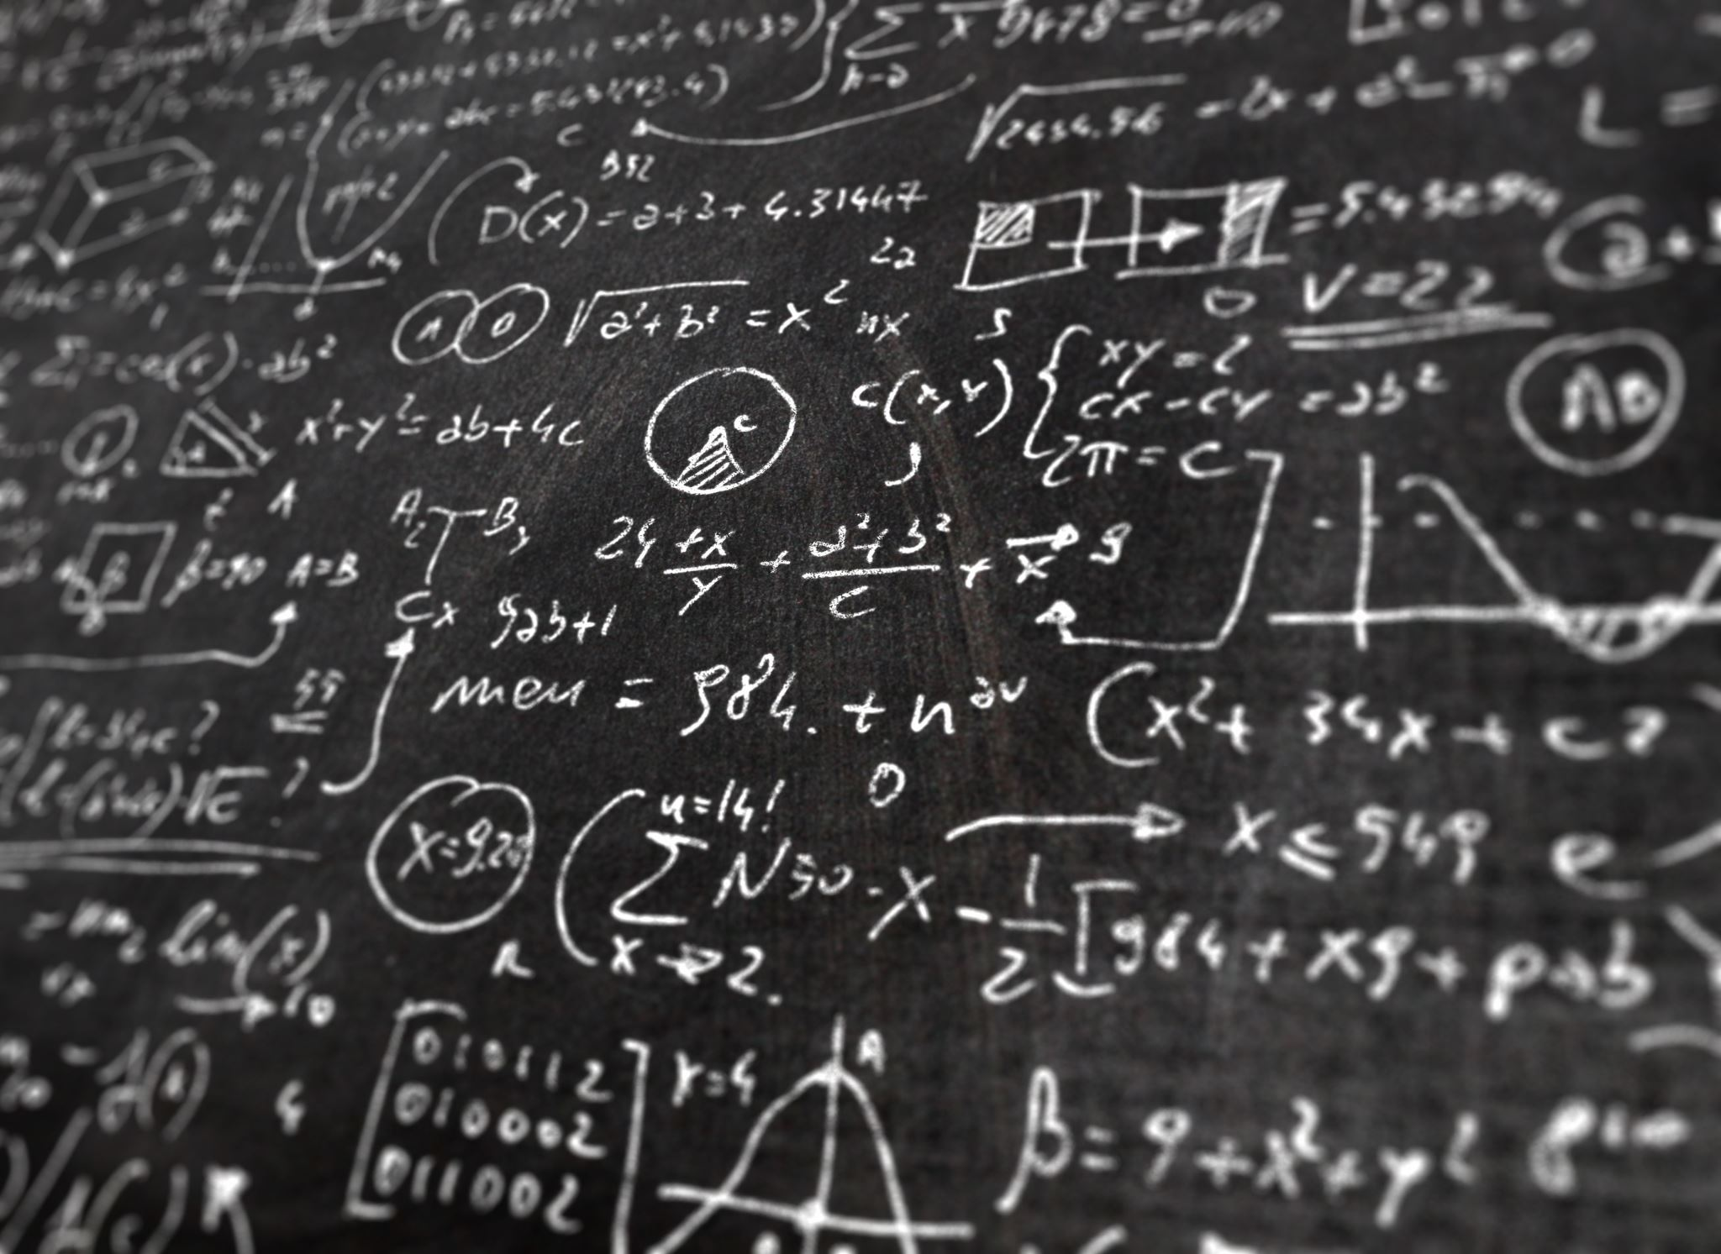
Co-existence of Precision and Beauty in Mathematics
By-Dr. Meena Sharma

Slide 2
Meaning and Definition
With Example

Slide 3
Precision
Details

Slide 4
Accuracy Vs Precision

Slide 5
Meaning of Mathematical Beauty

Slide 6
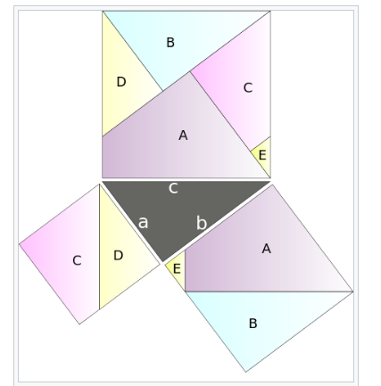
Beauty in Methods
Example

Slide 7
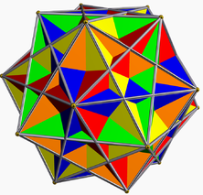
Beauty In Experience
Interest in pure mathematics that is separate from empirical study has been part of the experience of various civilizations, including that of the ancient Greeks, who "did mathematics for the beauty of it". The aesthetic pleasure that mathematical physicists tend to experience in Einstein's theory of general relativity has been attributed (by Paul Dirac, among others) to its "great mathematical beauty". The beauty of mathematics is experienced when the physical reality of objects are represented by mathematical models.

Slide 8
Unit-1 Completed
Stay Home and Stay Safe

